Slide 1
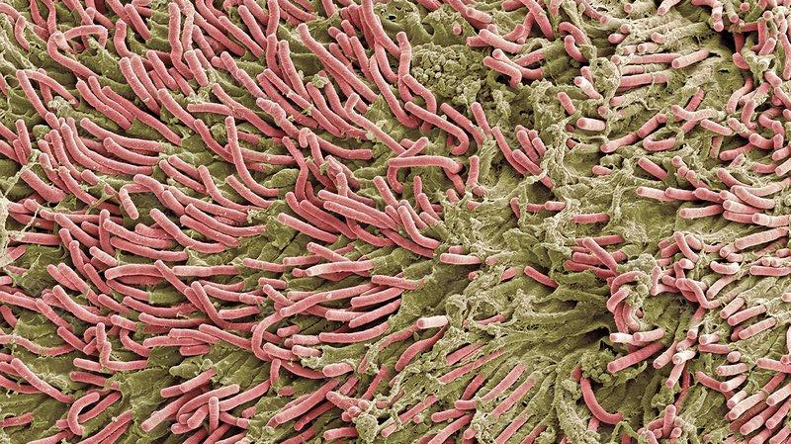
Dental Market
Biofilms

Slide 2
Global oral care market
Update 22.04.2020

Slide 3
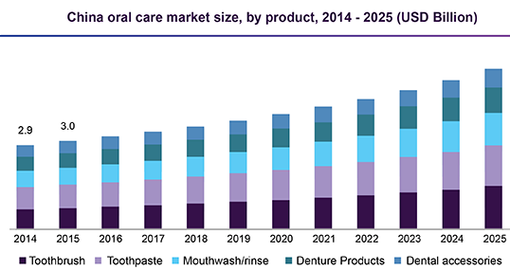
Market size – Cleaning Dental Equipment
The global dental market is estimated to reach US$40.9 billion in 2025
  CAGR of 5.59% (2018 to 2025)
  Main growth in the US, due to increased awareness
Growth sectors →
  Toothpaste, dominates market, expected to stagnate
  Mouthwash: herbal and flavored mouth- washes expected to grow in demand.
  Increase in occurrence of oral disorders such as periodontitis, gingivitis, tooth decay, denture irritation, bleeding gums, and bad breath is expected to contribute to demand for medicated as well as non-medicated mouthwashes
Key players: Procter & Gamble Company; Johnson & Johnson Consumer, Inc.; Colgate-Palmolive; GlaxoSmithKline; Church & Dwight Co., Inc.; Dr. Fresh, LLC; Dentaid; Lion Corporation; and Sunstar Suisse S.A, Danaher Corporation, Dentsply Sirona Inc., Straumann Holding AG, Zimmer Biomet Holdings Inc.
Notes:
Compound annual growth rate (CAGR)
https://www.grandviewresearch.com/industry-analysis/oral-care-market
https://www.bloomberg.com/press-releases/2019-11-12/global-oral-care-market-2019-2023-evolving-opportunities-with-church-dwight-co-inc-and-colgate-palmolive-company

Slide 4
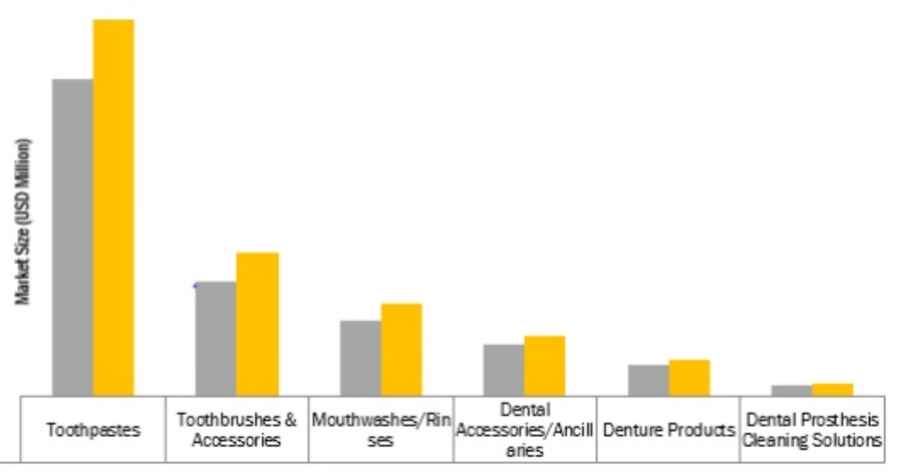
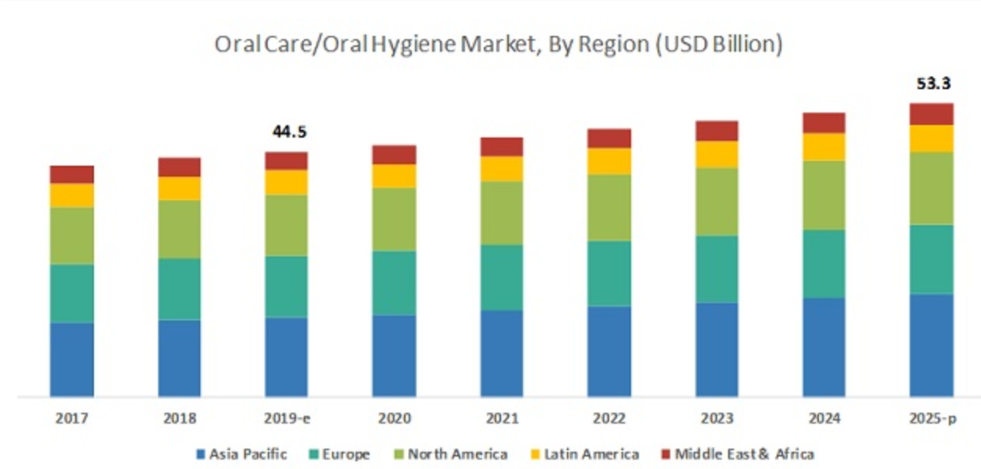
Oral Care/Oral Hygiene Market by Product
Toothbrush (Manual, Electric, Battery-Powered), Toothpaste, Mouthwash, Dental Floss, Teeth Whitening)
Notes:
https://www.marketsandmarkets.com/Market-Reports/oral-care-market-80546246.html
https://www.alliedmarketresearch.com/dental-consumables-market

Slide 5
Market Size – Dentist offices US
199,486 dentists in the US (2018)
131,118 offices (estimate, ADA)
  Stable and low growth rate ~1.2%
  Most dental practices are single-unit firms with less than 10 employees
22.3 million endodontic procedures were performed annually:
  15.2 million/68% were performed by general dentists
  5.7 million/26% were performed by endodontists
  The remainder were performed by other dental specialists
American Dental Association (ADA)

Slide 6
Waterlines of Dental Units

Slide 7
Microflora in Waterlines of Dental Units
Water conditions allow to grow over periods of down time, e.g. weekends
Dental water needs to meet CDC/EPA drinking water quality standard
  Bacteria level ≤500 CFU/mL
Diverse microflora of bacteria, yeasts, fungi, viruses, protozoa, unicellular algae and nematodes
  Found in waterlines, high-speed drills, air/water syringes, ultrasonic scalers
Organisms, isolated from dental unit waterlines
  P. aeruginosa may be isolated from 15% to 24% of samples; 2 x 10⁵ CFU/mL
  Legionella spp. are regularly isolated from; 10² to 10⁴ CFU/mL
  free-living amoebae, a host for L. pneumophila and P. aeruginosa
  Candida spp., Pseudomonas spp, streptococci, Fusobacterium spp
Biofilms concorded to be a host for nontuberculous mycobacteria
  Mycobacterium gordonae and Mycobacterium chelonae
  up to 400x higher than tap water concentrations
CFU colony-forming units
Notes:
https://www.cda-adc.ca/jcda/vol-66/issue-10/539.html
https://aem.asm.org/content/66/8/3363
https://www.ncbi.nlm.nih.gov/pmc/articles/PMC3312703/
https://www.rdhmag.com/infection-control/article/16406310/safe-water-delivery

Slide 8
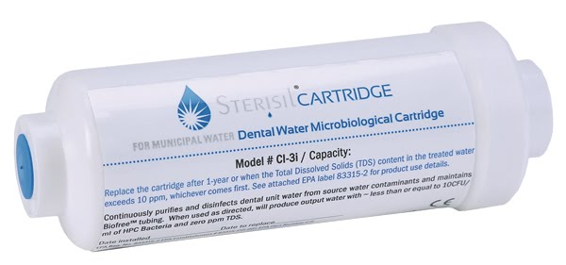
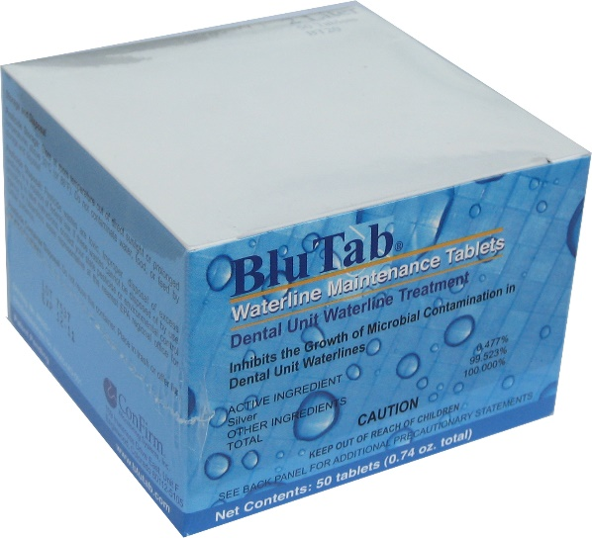
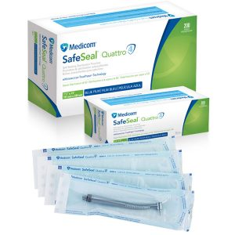
Microflora : Risk to Personnel and Patient
Microflora and biofilms present in dental waterlines
  despite decontamination procedures (chlorine tablets, silver ions, iodine releasing filters, UV)
  Sterile or pure water doesn’t prevent biofilm formation
  Treatment options vary in effectiveness and costs
Route of infection
  hematogenous spread during surgical procedures
  local mucosal (oral or conjunctival) contact
  ingestion
  Inhalation (Legionella pneumophila, Pseudomonas spp)
Health risk to immunosuppressed, elderly and chronically ill patients
Nasal flora of dentists may have a higher proportion of waterborne Pseudomonas spp.
Eventually eye infection with Acanthamoeba spp
Notes:
https://www.cda-adc.ca/jcda/vol-66/issue-10/539.html
https://aem.asm.org/content/66/8/3363
Guidelines : https://www.osap.org/page/Issues_DUWL_3/Dental-Unit-Waterlines-Dental-Unit-Water-Line-Fact-Sheet.htm

Slide 9
Dental and Periodontal diseases

Slide 10
Oral Biofilms - Locations
Dental Plaque
Denture / Bridges
  Denture stomatitis
  Candida albicans, a pathogenic fungus that colonizes the denture material polymethyl acrylate
  >65% of denture wearers have stomatitis, poor oral hygiene, diabetes
Dental implants
  Peri-implantitis
Procedures
  Root Canal Infections
Biofilms can lead to potentially to fatal systemic infections
  aspiration-pneumonia and chronic obstructive pulmonary disease (COPD)
Notes:
https://www.ncbi.nlm.nih.gov/pmc/articles/PMC6163956/
https://www.researchgate.net/publication/273463928_Biofilm_in_endodontics_A_review
https://onlinelibrary.wiley.com/doi/full/10.1111/iej.13050
https://www.ncbi.nlm.nih.gov/pmc/articles/PMC5578138/

Slide 11
Five top oral health diseases
The majority of oral health conditions are:
  dental caries (tooth decay)
  periodontal diseases
  oral cancers
  oral manifestations of HIV
  oro-dental trauma, cleft lip and palate, and noma (severe gangrenous disease starting in the mouth mostly affecting children)

Slide 12
Market size - Periodontal diseases
Periodontitis
  Market size US$ 900 Mn in 2025
  of 30–50% of US population; 10% have severe forms
  Chronic periodontitis affects about 750 million people or about 10.8% of the population as of 2010
  Gingivitis
  Chronic or Aggressive periodontitis
  Periodontitis as a manifestation of systemic disease
  Abscesses of the periodontium
Impact on global economy about $54B/year
Number of edentulous people projected to increase to 200M (US)
  36M Americans are toothless
  >120M Americans are missing at least one tooth
  90% have dentures
Notes:
https://www.transparencymarketresearch.com/pressrelease/periodontal-therapeutics-market.htm

Slide 13
Periodontal therapeutics
Antibiotics
  Arestin
  Periochip
  Atridox
  Others
Notes:
https://www.transparencymarketresearch.com/pressrelease/periodontal-therapeutics-market.htm

Slide 14
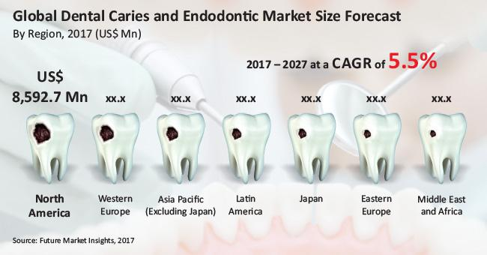
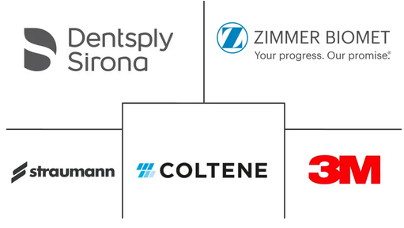
Market Size - Caries
Caries and endodontic market is predicted to grow to almost US$ 17.3 Bn in 2027 (CAGR of 5.1%)
89% of the North America dental caries and endodontic market
2.43 billion people (36% of the population) are affected with dental caries
Notes:
https://www.futuremarketinsights.com/reports/dental-caries-market
https://www.mordorintelligence.com/industry-reports/dental-caries-treatment-market

Slide 15
Market Size - Dentures stomatitis
Prevalence rates of 2.5-18.3% in adults aged 35-44 years or 65-74 years are reported, with a predominance in the latter age group
Denture Disinfectants
  USD 525 Mn in 2029; 70% US and EU
  Ultrasonic Denture Cleaners, Consumables, Tablets, Creams and Pastes, Gels and Solutions
  GSK + Prestige Consumer Healthcare Inc own ~49% market
  Others: Renfert GmbH, ICPA Health Products Ltd, Colgate-Palmolive Company, Fittydent International GmbH,., Procter & Gamble, Johnson & Johnson, Valplast International Corp., L&R Manufacturing Company
Notes:
https://www.factmr.com/report/1110/denture-disinfectants-market
Denture companies: https://www.marketwatch.com/press-release/denture-market-size-share-2019-global-business-trends-share-progress-insight-modest-analysis-statistics-regional-demands-and-forecast-to-2024-2019-11-01
https://emedicine.medscape.com/article/1075994-overview

Slide 16
Market Size – Root Canal Biofilm
~15.1 million root canal treatments were performed annually
  10.9 million / 72% were performed by general dentists
  4.2 million / 28% were performed by endodontists
Corresponds to $16.5B for procedure alone
90% procedures successful. No data if the 10% are due to infections or others reasons
Left untreated, exacerbating root canal infections can be an immediate threat to systemic health, with nearly 7000 hospitalizations per annum reported in the US alone
Treatments
  Irritants (Proteolytic Irrigants (Sodium hypochlorite), Antiseptics, Demineralizing Agents, Natural Agents)
  Nanoparticles Based Disinfection (Chitosan, zinc oxide, silver nanoparticles)
    Rapid uptake
  Photodynamic therapy
    Rose bengal, a non-toxic dye, becomes cytotoxic when activated with a low-intensity visible light and oxygen
Notes:
https://onlinelibrary.wiley.com/doi/full/10.1111/iej.13050
https://www.ncbi.nlm.nih.gov/pmc/articles/PMC5578138/
https://www.aae.org/specialty/about-aae/news-room/endodontic-treatment-statistics/
https://www.ncbi.nlm.nih.gov/pmc/articles/PMC4601489/

Slide 17
Market Size – Biofilms and Dental implants

Slide 18
Biofilm Formation

Slide 19
Biofilm formation in the Oral cavity
  Early biofilm: primarily Gram-positive cocci
  3–4 days increased numbers of filaments and fusiforms
  4–9 days undisturbed: more complex flora with rods, filamentous forms
  7–14 days: Vibrio species, spirochetes, more Gram-negative organisms
Early colonisers
mainly Streptococcus species (60-90%)
Eikenella spp.
Haemophilus spp.
Prevotella spp.
Priopionibacterium spp.
Capnocytophaga spp.
Veillonella spp.
Late colonisers
A. actino- mycetemcomitans
Prevotella intermedia
Eubacterium spp.
Treponema spp.
Porphyromonas gingivalis
Fusobacterium nucleatum is found between the early and late colonisers, linking them together.
Notes:
Early colonisers
mainly Streptococcus species (60-90%)
Eikenella spp.
Haemophilus spp.
Prevotella spp.
Priopionibacterium spp.
Capnocytophaga spp.
Veillonella spp.
Late colonisers
A. actino- mycetemcomitans
Prevotella intermedia
Eubacterium spp.
Treponema spp.
Porphyromonas gingivalis
Fusobacterium nucleatum is found between the early and late colonisers, linking them together.

Slide 20
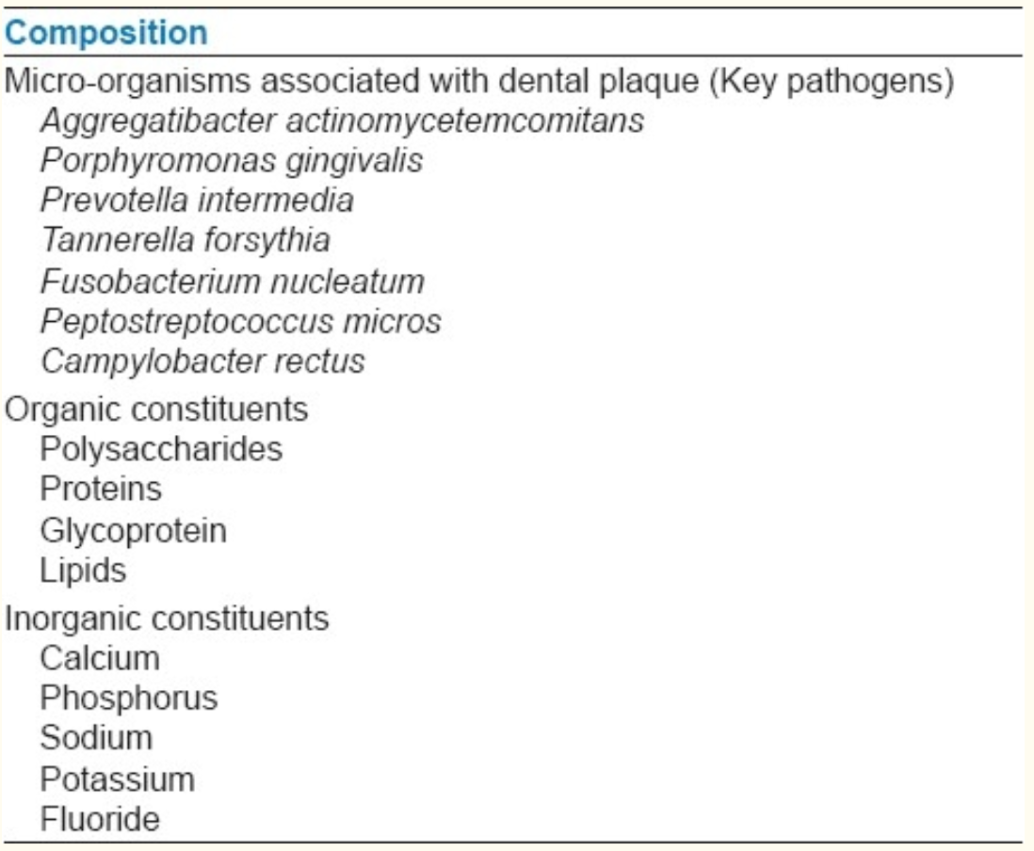
Composition of Oral biofilms
eDNA
Notes:
https://www.ncbi.nlm.nih.gov/pmc/articles/PMC3312703/
https://www.sciencedirect.com/science/article/abs/pii/S1286457915000672

Slide 21
Detecting Biofilm
Grow a swap on a plate
  Requires cell culture equipment
Dental Plaque Disclosing Agent
  Phloxine B - antimicrobial substance, viability dye and biological stain
  Erythrosine - pink dye, primarily used for food coloring
Mechanical / texture of surfaces

Slide 22
Common Treatments
Mouthwash with Chlorhexidine
  is active against Gram-positive and Gram-negative organisms, facultative anaerobes, aerobes, and yeasts
  Discolors enamel
  20 mL twice a day of concentrations of 0.1% to 0.2%
  reduction in gingivitis over 6 months of use
  Interacts with anionic compounds in toothpaste, use wash 30 min after brushing
Herbal-based mouth rinses
  Centella asiatica, Echinacea purpurea, and Sambucus nigra
  botanical oral rinse displayed a clear advantage over control in preventing plaque formation and gingival inflammation
H₂O₂
  Short term effect, quick repopulation from plaque
Notes:
https://www.ncbi.nlm.nih.gov/pmc/articles/PMC6163956/

Slide 23
Companies / Products

Slide 24
Ongoing Developments

Slide 25
Ongoing Tech / Product Developments
Bacteriophages
  bacteriophage disrupts a biofilm from within the matrix by killing the bacterial cells. Limitations are the ECM.
Antimicrobial peptides (AMPs)
  destabilize bacterial membranes through electrostatic interactions
Quorum sensing / Quorum Sensing Inhibitors
  Disrupt cell-cell communication
  used by microbes to control gene expression with regards to phenotype
Notes:
https://www.ncbi.nlm.nih.gov/pmc/articles/PMC6163956/
https://www.ncbi.nlm.nih.gov/pubmed/11544353/
https://www.ncbi.nlm.nih.gov/pmc/articles/PMC3312703/

Slide 26
Ongoing Tech / Product Developments
Continuously deliver warm NaOCl via new devices based on negative pressure
Alternatively, techniques such as ultrasonic activation also increases the temperature of the irrigating solution and may prove to be beneficial
Notes:
https://www.ncbi.nlm.nih.gov/pmc/articles/PMC5578138/

Slide 27
Studies

Slide 28
Appendix

Slide 29
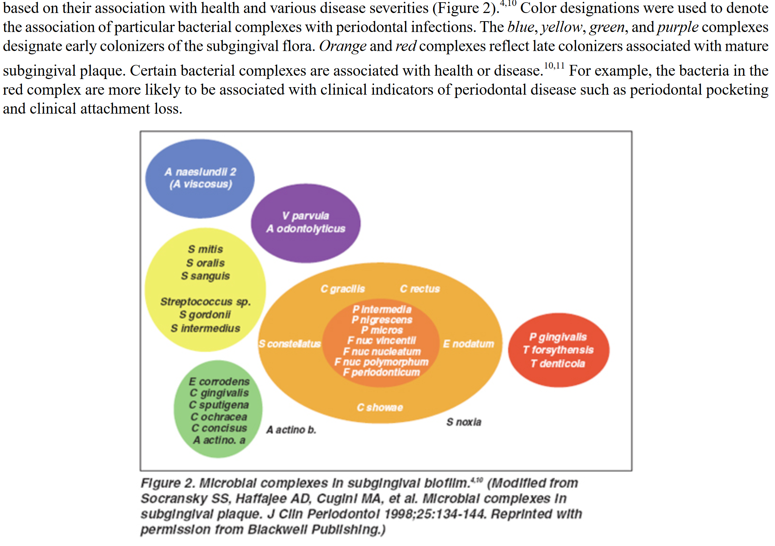
Notes:
https://jdh.adha.org/content/jdenthyg/81/suppl_1/116.full.pdf

Slide 30
NORTH AMERICA RESTORATIVE DENTISTRY - MARKET SEGMENTATION
By Product
Restorative Materials
Direct Restorative Material
Amalgam
Composites
Glass Ionomers
Other Direct Restorative Materials
Indirect Restorative Materials
Metal-Ceramic
Ceramic
Other Indirect Restorative Materials
Biomaterials
MTA
Biodentine
Etching and Bonding Agents/Adhesives
Dental Impression Materials
Implants
Prosthetics
Restorative Equipment
CAD/CAM Systems
Handpieces
Rotary Instruments
Light Curing Equipment
Casting Devices
Mixing Devices
Furnaces
Articulating Equipment
By End User
Hospitals and Clinics
Dental Laboratories
Dental Schools and Research Institutes
By Geography
North America
US
Canada
Mexico
Company Profiles
Danaher
3M
Dentsply Sirona
Ivoclar Vivadent AG
Ultradent Products Inc.
Institut Straumann AG
Zimmer Biomet
GC Corporation
Mitsui Chemicals, Inc.
VOCO GmbH
Brasseler USA
DiaDent Group
Notes:
https://www.reportlinker.com/p05783144/North-America-Restorative-Dentistry-Market-to-Regional-Analysis-and-Forecasts-by-Product-End-User-and-Country.html?utm_source=PRN

